Slide 1
Examlet 1 practice

Slide 2
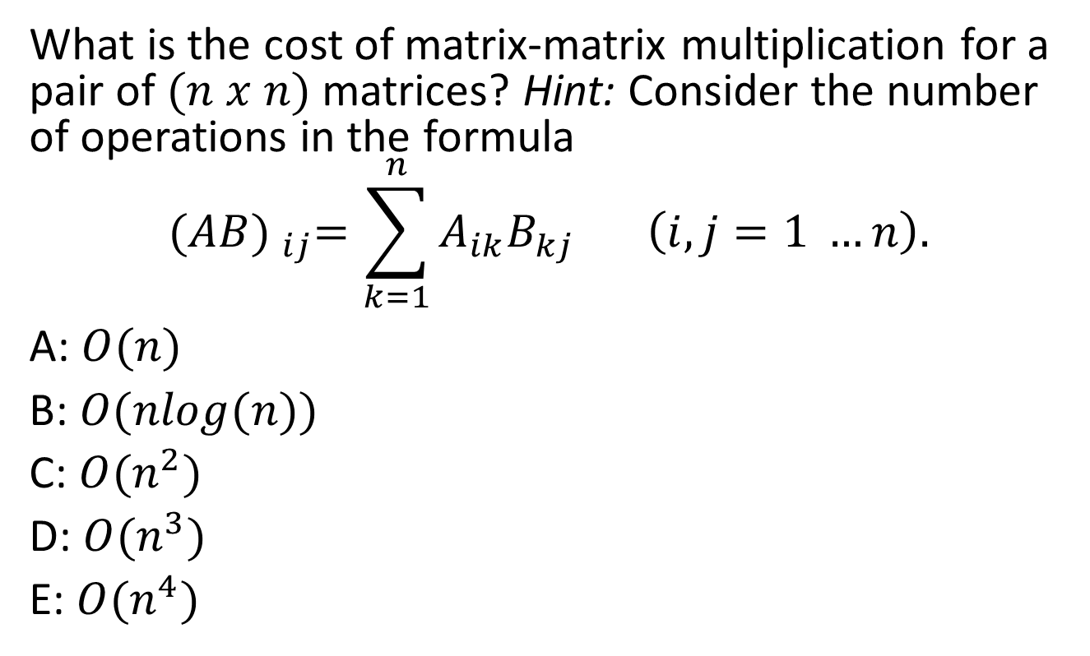
1
What is the cost of matrix-matrix multiplication for a pair of $(n x n)$matrices? Hint: Consider the number of operations in the formula
$${(AB) }_{ij}=\sum_{k=1}^{n}{A_{ik}B_{kj}} \left(i,j=1 …n\right).$$
A: $O(n)$
B: $O(nlog(n))$
C: $O(n^{2})$
D: $O(n^{3})$
E: $O(n^{4})$

Slide 3

2
Which of the following is not $O(n3)$?
A: $(n^{2} + 1)log⁡(n^{5})$
B: ${\left(1000\right)}^{40}n^{3}−1/n^{4}$
C: $n^{3.5}$
D: $n^{2.5}$

Slide 4
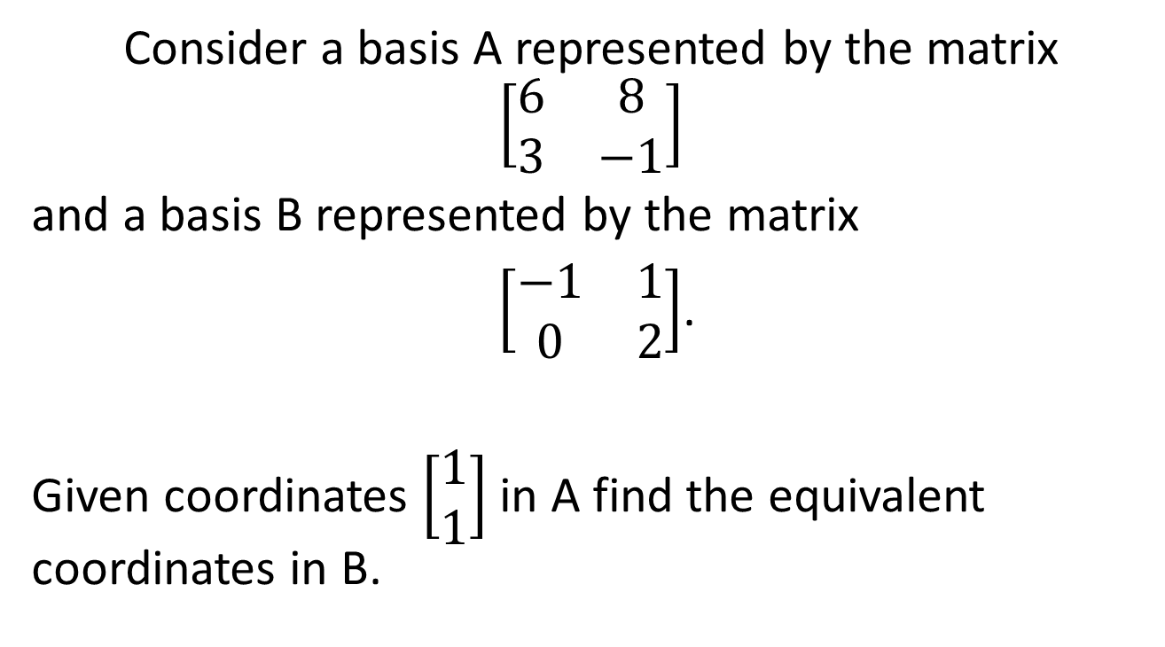
3
Consider a basis A represented by the matrix $\left[\begin{matrix}6 & 8 \\ 3 & −1\end{matrix}\right]$
and a basis B represented by the matrix
$\left[\begin{matrix}−1 & 1 \\ 0 & 2\end{matrix}\right]$.
Given coordinates $\left[\begin{matrix}1 \\ 1\end{matrix}\right]$ in A find the equivalent coordinates in B.

Slide 5
4
You are given a (6 x 7) numpy array A. Write a correct line of Python code using A that returns a (2 x 6) matrix.

Slide 6
5
What must be true for the Taylor expansion of a function to be useful for approximation? (Hint: Consider the function, expansion point, and evaluation point. There may be multiple.)

Slide 7

6
What is the Taylor expansion of $cos⁡(x)$around $x=0$ up to the fourth derivative term?

Slide 8
General topics to study
Python/Numpy
Taylor series
Linear algebra
Big-O
Review quizzes, homework, lecture material

