Slide 1
Examlet 2 Practice

Slide 2
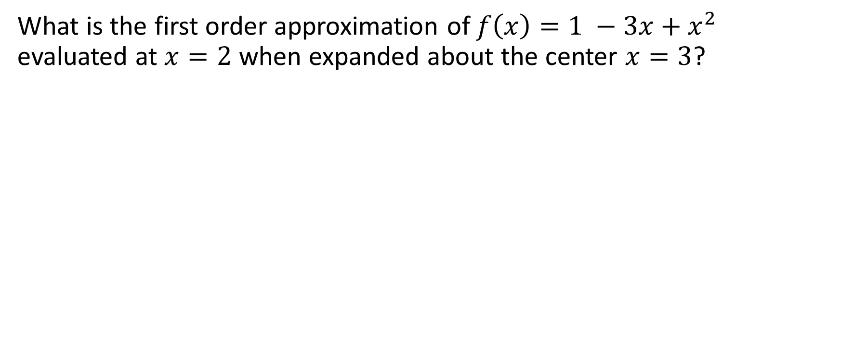
Shifted Taylor expansion
What is the first order approximation of $f\left(x\right)=1 −3x+x^{2}$ evaluated at $x=2$ when expanded about the center $x=3$?

Slide 3
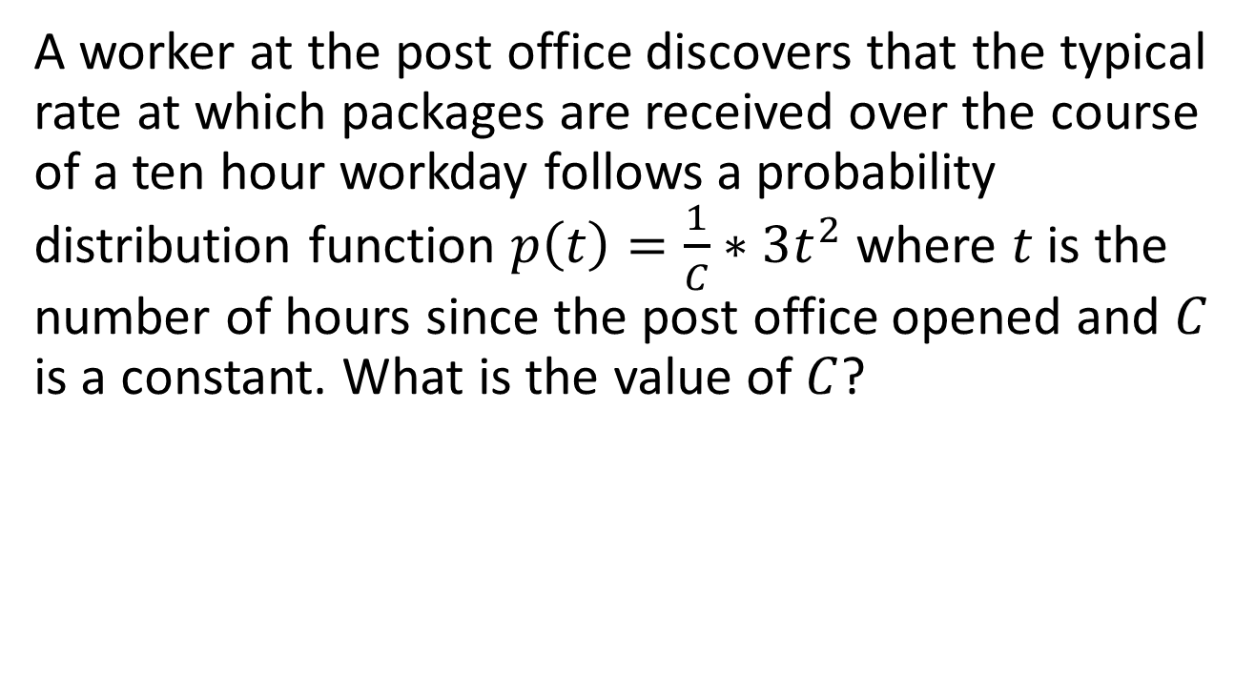
Distribution function
A worker at the post office discovers that the typical rate at which packages are received over the course of a ten hour workday follows a probability distribution function $p\left(t\right)=\frac{1}{C}∗3t^{2}$where $t$ is the number of hours since the post office opened and $C$ is a constant. What is the value of $C$?

Slide 4
Interpolating function
In general, on what factors does the accuracy of an interpolating function depend? (i.e. what can cause an interpolating polynomial to give poor results?)

Slide 5
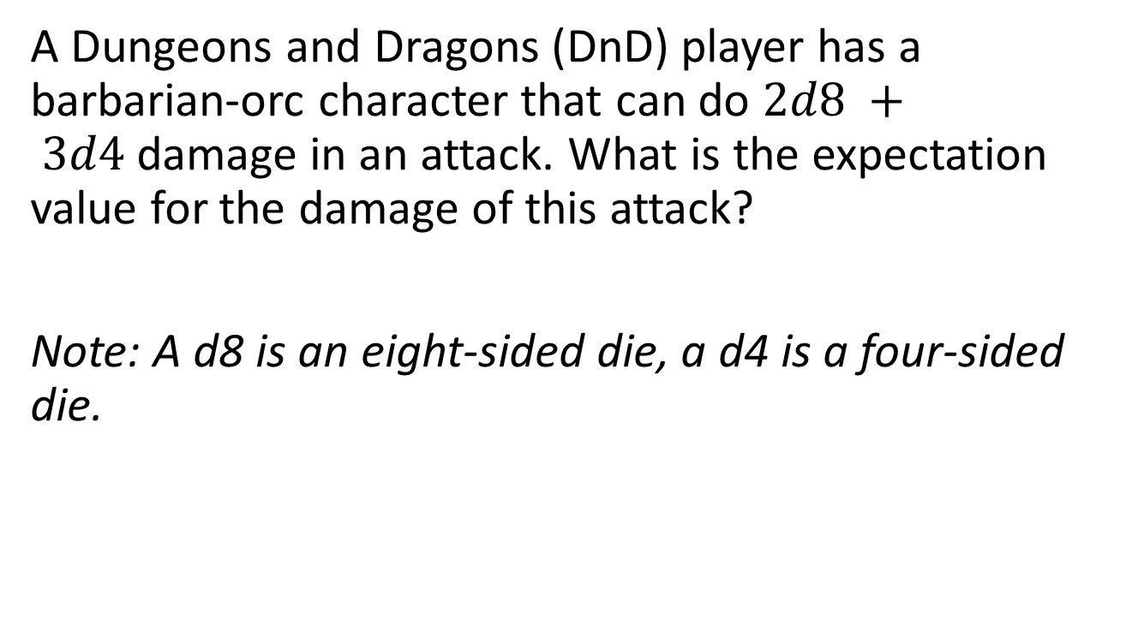
Expectation value
A Dungeons and Dragons (DnD) player has a barbarian-orc character that can do $2d8 + 3d4$damage in an attack. What is the expectation value for the damage of this attack?
Note: A d8 is an eight-sided die, a d4 is a four-sided die.

Slide 6
Vandermonde
Given three data points (-2, -27), (0, -1), and (1, 0) create the system of linear equations to solve for the coefficients of the interpolating polynomial. (Optionally, you may solve the system.)

Slide 7
Interpolation error
Suppose you are given four equally interpolation points separated by interval h. The error for this interpolation is found to be 0.1. What error would be expected if we instead spaced the points by an interval h/3 on a subinterval of the original interval?

Slide 8
General topics
Prior topics
Interpolation
Monte Carlo

