Slide 1
Examlet 3 practice

Slide 2
Random number generator
Consider a random number generated by recording the least significant digits of a computer’s clock at the moment the mouse is clicked. What are disadvantages to generating a random number in this way?
A: A specific series of data is not reproducible
B: This method is not portable across different systems
C: The generated numbers are not evenly distributed.
D: The series of data have a short period

Slide 3

Condition number
Consider a function $f\left(x\right)=x^{3}$. Let the input value be $x$ with uncertainty $∆x$. Estimate the lower limit of the condition number for $f(x)$at the point $x =2$.

Slide 4
Floating point
Convert the decimal number 15.625 to floating point representation. Write the significand in binary and the exponent in decimal.

Slide 5

Transformation
A sound mixer has a note composed of harmonic frequencies $c=1h_{1}+2h_{2}+3h_{3}$. She wants a note composed of harmonic frequencies weighted like $f=4h_{1}+2h_{2}+1h_{3}$. What is a transformation matrix that will convert from c to f in the basis of $h_{i}$?

Slide 6
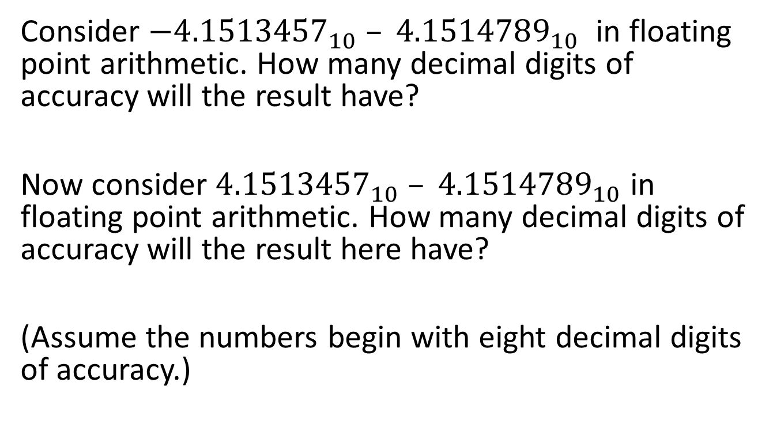
Floating point arithmetic
Consider $−{4.1513457}_{10} – {4.1514789}_{10}$ in floating point arithmetic. How many decimal digits of accuracy will the result have?
Now consider ${4.1513457}_{10} – {4.1514789}_{10}$ in floating point arithmetic. How many decimal digits of accuracy will the result here have?
(Assume the numbers begin with eight decimal digits of accuracy.)

Slide 7
Topics to review
Floating point
Error
Vectors and arrays
Older topics
  Taylor
  Monte Carlo
18 questions

