Slide 1
Group discussion 0
Introduction to python

Slide 2
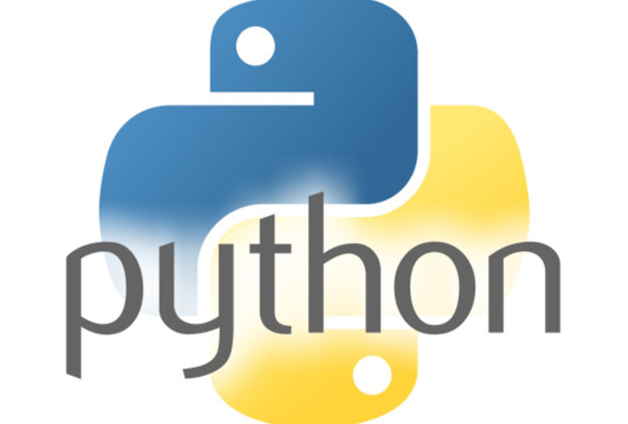
Why Python?
Free and open source
Large set of scientific computing libraries
Many other libraries when needed
Code is readable and easy to write

Slide 3
Running Python in this class
Install VirtualBox and downloading image
  -Link at bottom of Relate page
  https://relate.cs.illinois.edu/course/cs357-f16/
Running the image
  File -> Import appliance
Run code from Notebook
  Link on desktop

Slide 4
Introduction to Python
Printing
print(‘Hello world’)
Variables
  Don’t need to specify type
Commenting
  #for line comments
  ‘’’Triple single quotes for block comments’’’

Slide 5
If, else if, else blocks
if stockPrice < targetPrice:
print(‘better buy’)
elif stockPrice > targetPrice:
print(‘better sell’)
else
print(‘don’t do anything’)
  Else if -> elif
Practice it:
Write a program in using if, elif, and else statements that returns a letter grade (A, B, C, D, F) given a variable g with a numerical grade.

Slide 6
For loops and while loops
for i in range(0, 10):
print(i)
time = 0.0
endTime = 10.0
while time < endTime:
time += 0.1
print(time)
  For loops iterate over lists
Practice it:
Write a program that sums the numbers 1 to 100 and prints the result

Slide 7
Creating Numpy arrays
Import numpy as np
B = np.array([[0,0,17,31],[0,0,0,5],[0,0,0,0],[0,14,0,0]])
print(B)
#Alternative method
shape = [4, 4]
B = np.zeros(shape) #<---- the dimensions need to be inside a list
B[0, 2] = 17
B[0, 3] = 31
B[1, 3] = 5
B[3, 1] = 14

Slide 8
Accessing numpy arrays and matrix multiplication
Matrix locations accessed the same way they are set
x = B[0, 3]
Use @ operator to multiply two matrices of appropriate dimensions together
C = A @ B
Practice it: Write a program that creates two (2x2) numpy matrices A and B, multiplies them together using @, and stores the result in C.

Slide 9
Python functions
Basic synax
def functionName(parameter0, parameter1,…):
#Do stuff in here…
ans = …
return ans
Example: def getHello(helloVersion):
if helloVersion == 0:
return ‘Hello world’
else
return ‘Hello Illinois’
Practice it:
Write a function that takes two Numpy matrices, A and B, as parameters and returns the sum of their [0, 0] entries.

Slide 10
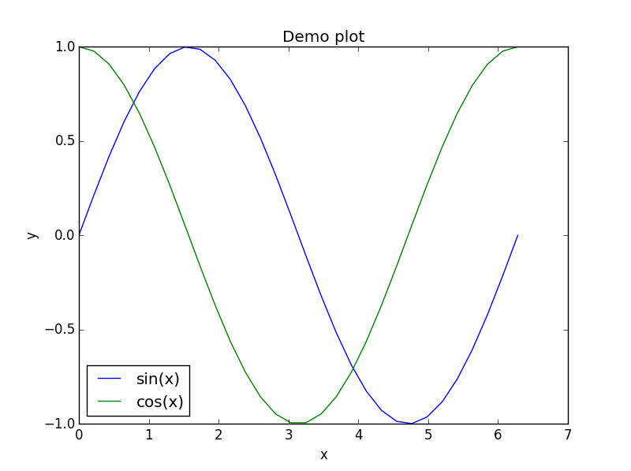
Matplotlib, math functions, and numpy math functions
import matplotlib.pyplot as plt
import math
import numpy as np
x = np.linspace(0, 2*math.pi, 30, endpoint=True)
y = np.sin(x)
z = np.cos(x)
plt.plot(x,y, label='sin(x)')
plt.plot(x,z, label='cos(x)')
plt.legend(loc=0)
plt.xlabel('x')
plt.ylabel('y')
plt.title('Demo plot')
plt.show()

Slide 11
Python dictionaries
Data structure of key-values pairs with fast read and write (provided you know the key)
  Implemented as hash table under the hood
d ={'hammer': 5, 'nails': 2, 'drillbit': 3, 'screwdriver': 1, 'bike': 1, 'mattress': 2, 'pillow': 1, 'stuffed animal': 2}
#Alternatively we might need to update an existing dictionary
warehouseList = ['hammer', 'nails', 'hammer', 'hammer', 'screwdriver', 'drillbit', 'nails', 'mattress', 'stuffed animal', 'drillbit', 'hammer', 'pillow', 'bike', 'hammer', 'mattress', 'drillbit', 'stuffed animal']
d = dict() #empty dictionary
for i in warehouseList: #Note that we can iterate directly over a list
if(d.get(i) == None): #None is a special value like NULL
d.update({i: 1})
else:
d.update({i: d.get(i) + 1})
print(d)

Slide 12
Python dictionaries (cont.)
Helpful functions
  d.keys() – returns a list of keys in the dictionary
  d.values() – returns a list of values in the dictionary
  d.items() – returns all key-value pairs in the dictionary
  d.get(key) – returns the value paired with key or None if there is no value paired with key

Slide 13
Nested dictionaries
The values of a dictionary can be any object. Since dictionaries are objects we can make them a value inside another dictionary
#Test number – score pairs
tyreseScores = {1:80, 2:85, 3:90}
heinrichScores = {1:90, 2:75, 3:80}
kimScores = {1:95, 2:90, 3:60}
liScores = {1:83, 2:93, 3:100}
#Student – gradebook pairs
studentsDict = {'Tyrese':tyreseScores, 'Heinrich':heinrichScores, 'Kim':kimScores,'Li':liScores}
print(studentsDict)
Practice it: Write code that outputs the score of each student on each test.

Slide 14
End!

